Slide 1

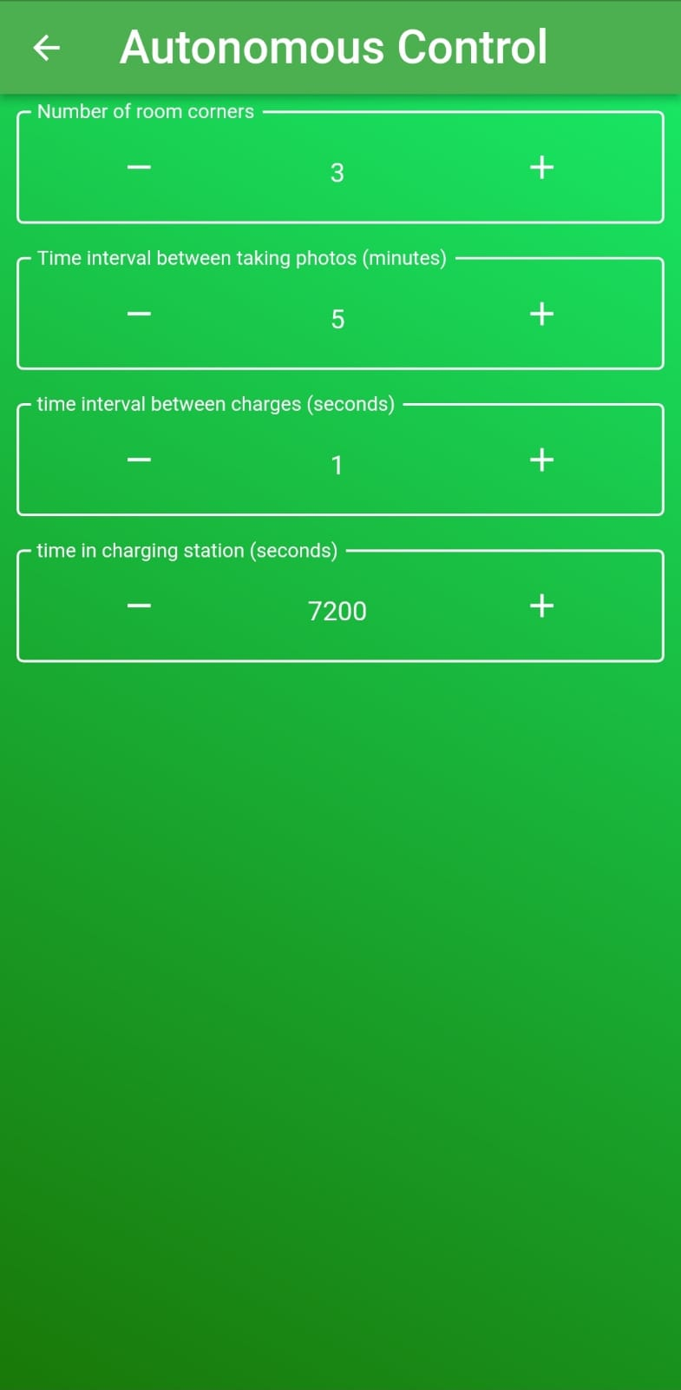
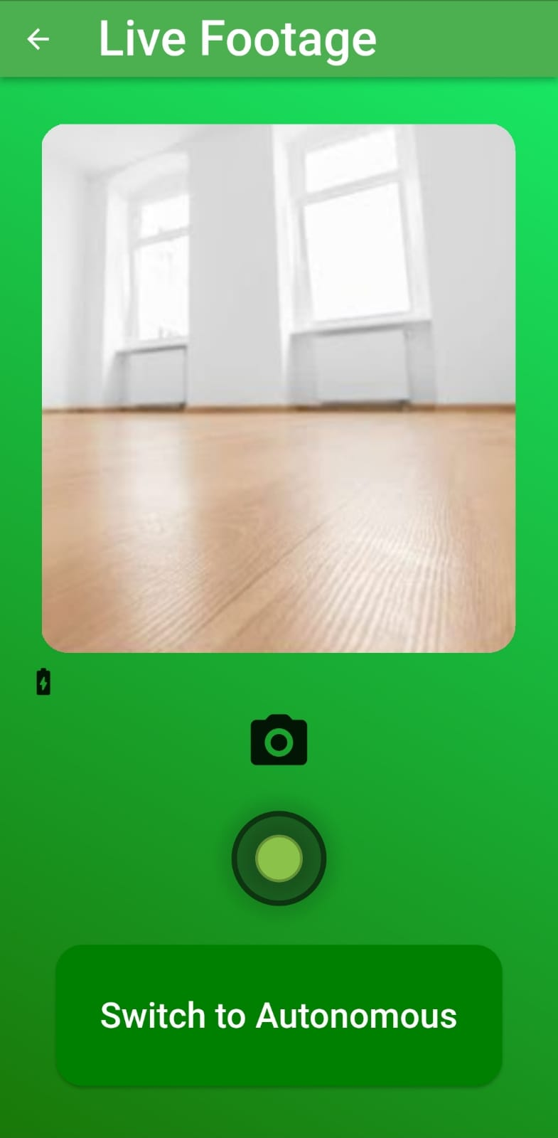

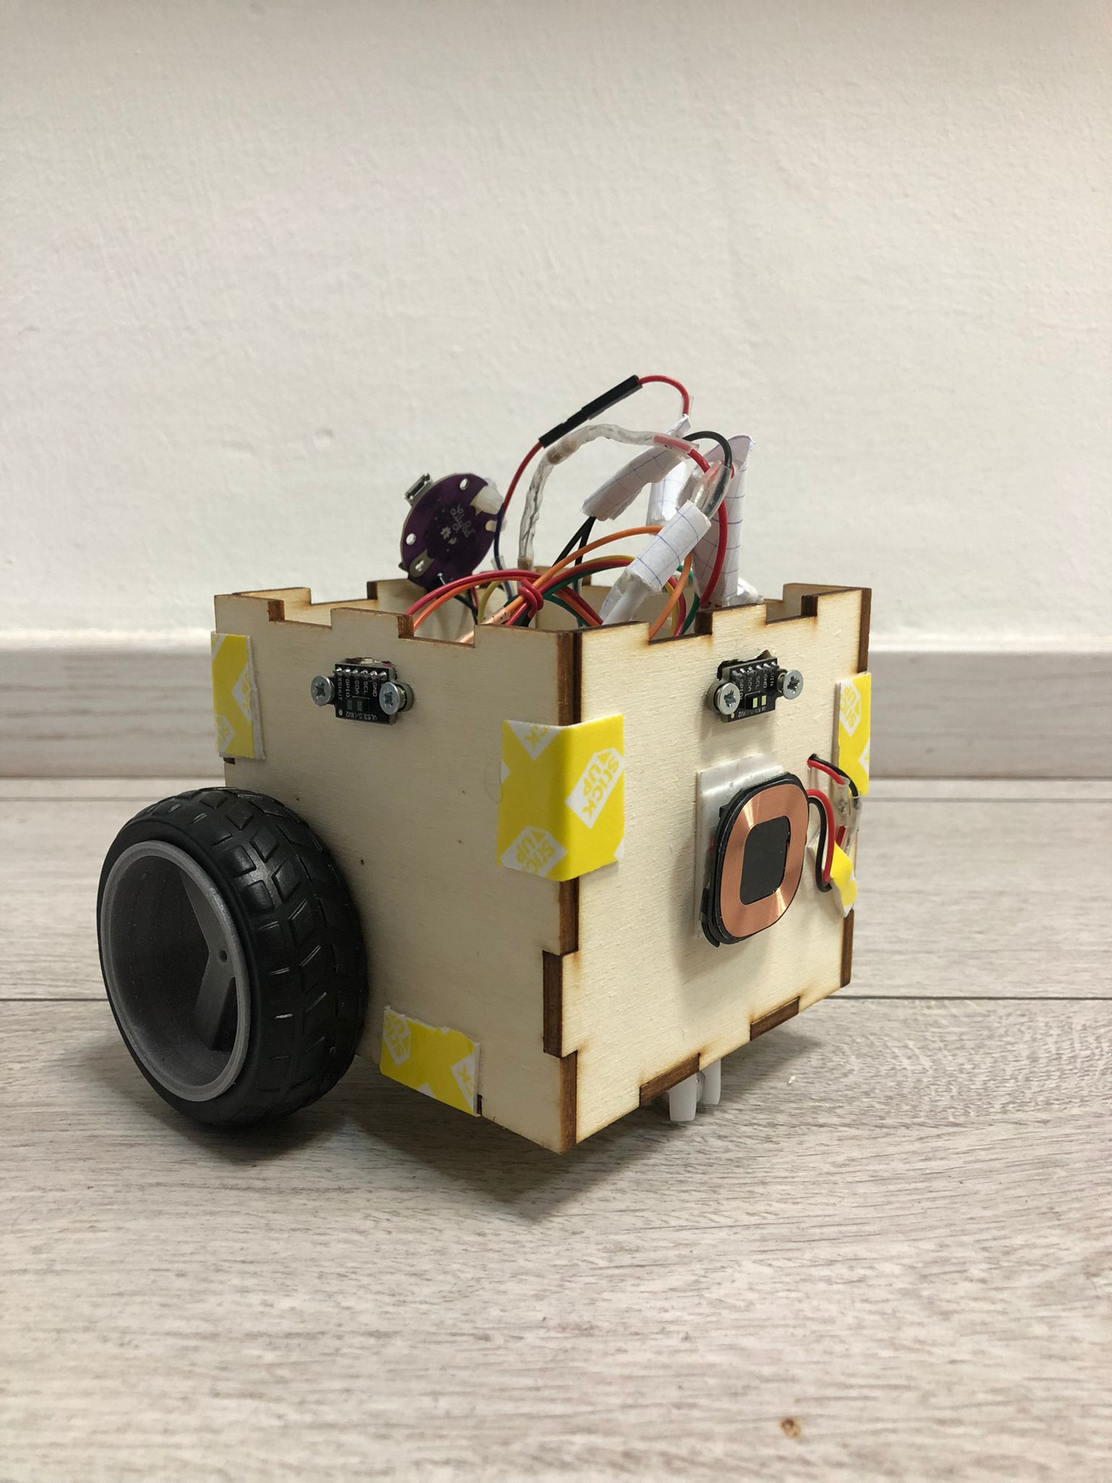
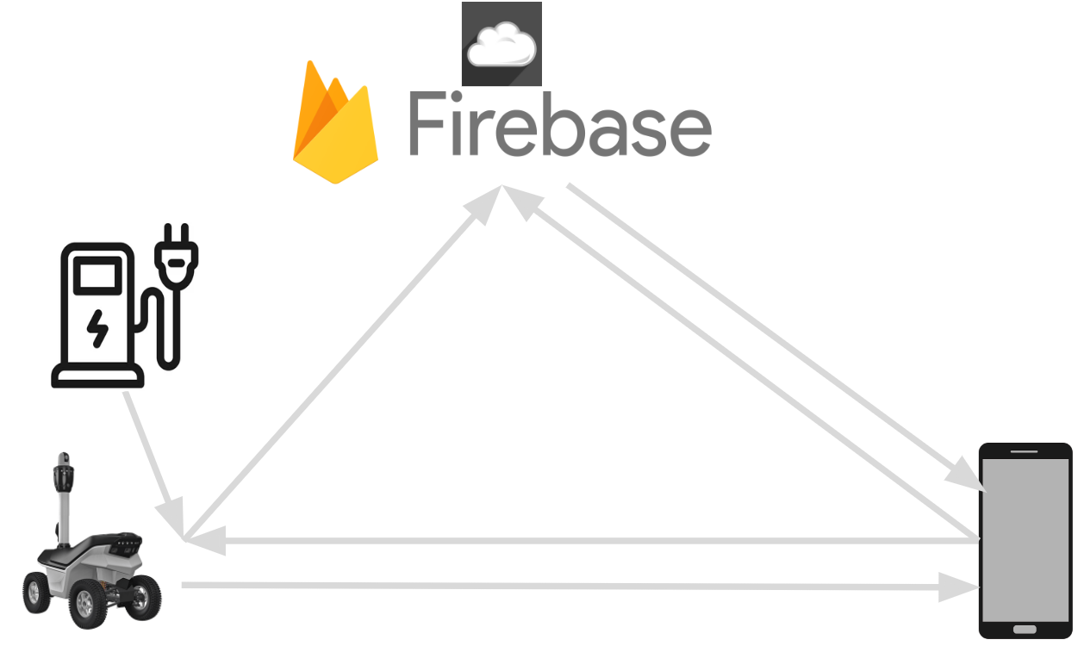
Hi-Robot
Secure your home today!
Goal: Secure our house using simple, low maintenance tech solution.
Solution: A small house security robot controlled using an app.
Main Features:
Autonomous and manual controlling modes.
Live streaming and footage library placed in the cloud.
Charging station – that the robot can connect to autonomously.
New innovate small security robot, integrates multiple sensors and can be update to more complex versions of an autonomous robot.
System diagram
Prototype photo
Control page
Live video page
App saved footage page
Roi Yona, Itamar Juwiler & Jonathan Breitman
Instructor: Tom Sofer, Harel Vaknin

